Slide 1


SAP UI5 & FIORI with OData TRAINING
Anubhav Oberoy & Nishan Nainsukha
Day – 5

Slide 2

Agenda
---jQuery---
Introduction to jQuery
Syntax of jQuery
Exercise on jQuery
Content Delivery Network
---Node JS---
Introduction to Node JS
Steps to use an external library using node JS
Uses of Node JS
Client Server Architecture
Exercise on Node JS
---SAP UI5--
Introduction to UI5
Responsive web design
Structure of UI5 Framework
Introduction to UI5 SDK

Slide 3
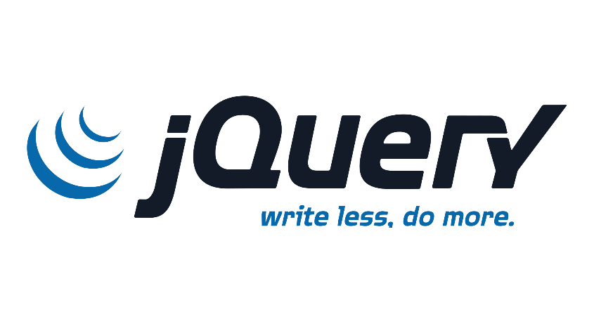

Introduction to jQuery
jQuery is a java script library which is an Open Source.
The purpose of jQuery is to make it much easier to use JavaScript on your website.
It is designed to simplify the client-side scripting of HTML.
The benefits of jQuery are:
It’s free to use
Used by top software companies like google, Netflix, etc.
Light weight JS library
jQuery greatly simplifies JavaScript programming.
Available on internet
Purpose is to write less and do more
It is an industry standard to build applications
jQuery has clean and beautiful syntax

Slide 4
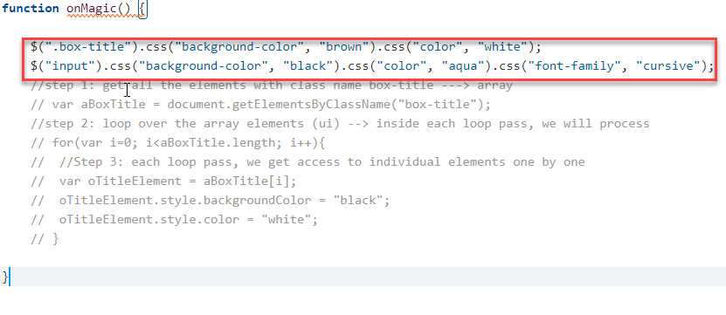
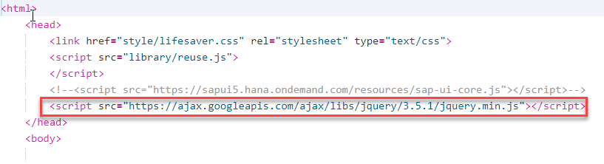
Syntax of jQuery
Syntax:-
$(selector).action();
Selector:-
tagName, .className, #id
Where:
A $ sign to define/access jQuery.
A (selector) to "query (or find)" HTML elements
A jQuery action() to be performed on the element(s)
Examples:
$(this).hide() - hides the current element.
$("p").hide() - hides all <p> elements.
Reference: https://jquery.com/
Exercise code link for CSS using jQuery:
index.html
reuse.js
Style.css

Slide 5

Exercise on more functionality
Exercise 1: Code link for Hide and Show HTML Box using Hide and show
index.html
reuse.js
Style.css
Exercise 2: Code link for API call and Animation on Image
index.html
reuse.js
Style.css

Slide 6
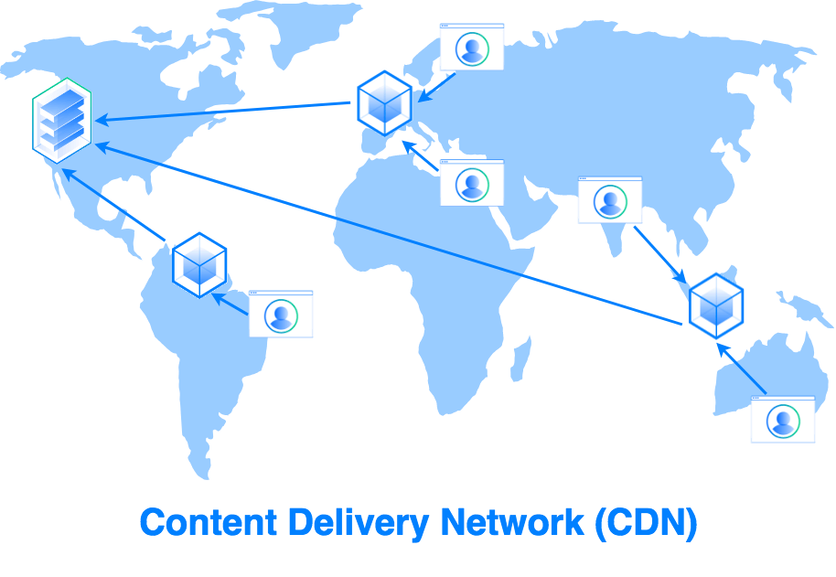
Content Delivery Network
A content delivery network (CDN) is a group of geographically distributed servers that speed up the delivery of web content by bringing it closer to where users are.
CDNs are a layer in the internet ecosystem.
Different loading time for users at different locations.
USA
Miami
Detroit
Mycode.js
Server
Mumbai
Mycode.js
India
Bangalore
Mumbai
Japan
Tokyo
Hongkong

Slide 7
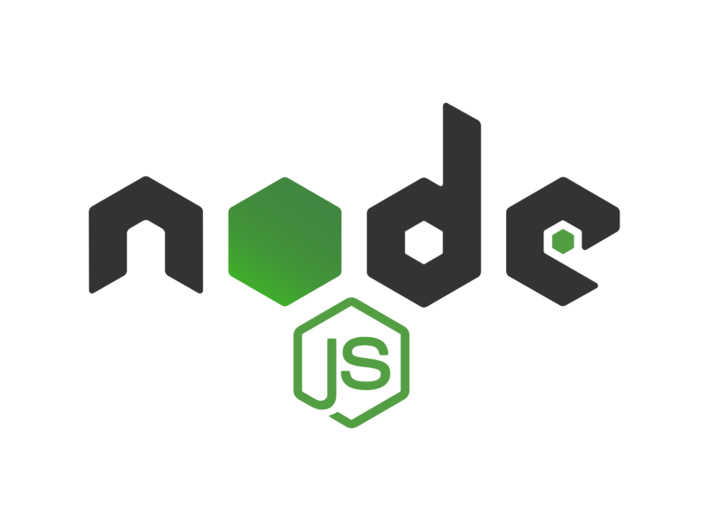
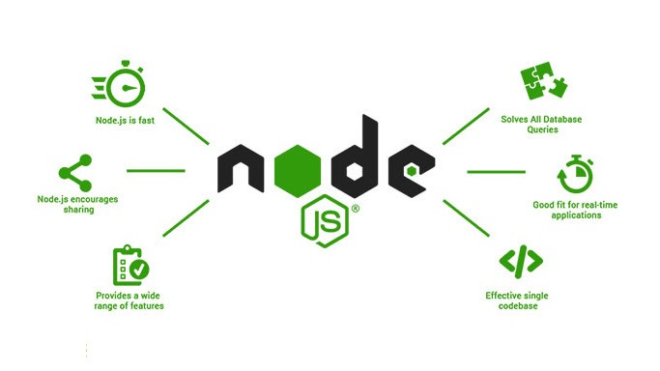
Introduction NodeJS
Node JS is an open-source, cross platform, java script runtime environment and used to execute Java Script on Server Side.
Node JS is also a great web framework for beginners because it works great for data intensive applications like streaming, gaming and real time apps. It leverage the power of JS’s Asynchronous non blocking IO.
As an asynchronous event-driven JavaScript runtime, Node.js is designed to build scalable network applications.
Node JS is a framework which allows us to run JS code outside browser. The main benefit is that a development do not need to learn multiple programming language
https://npmjs.com
Exercise code link for CSS using jQuery:
myfirstnodejs.js
package.json

Slide 8
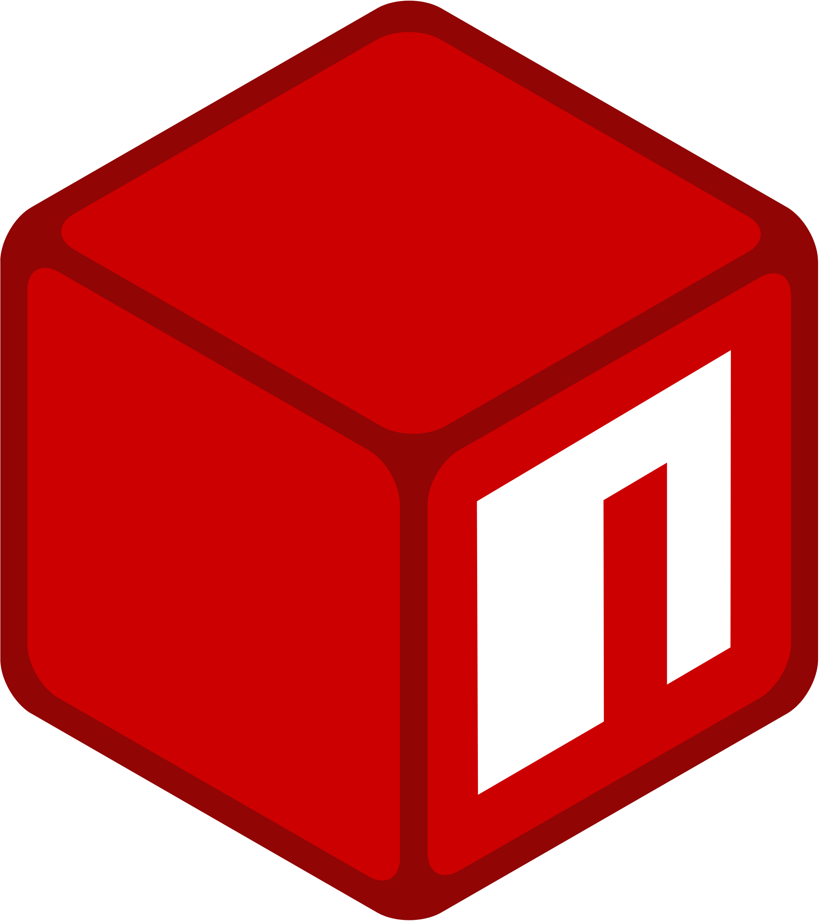
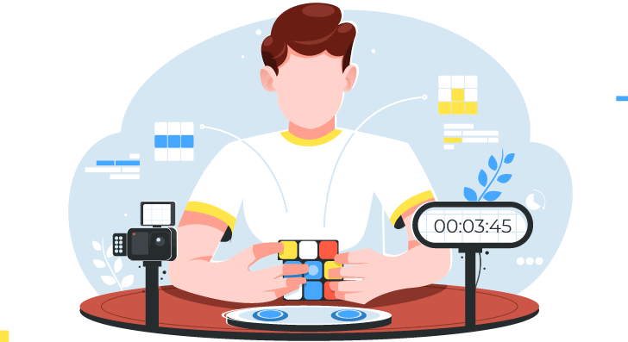
Steps to use an external library using node JS
Find the library (module) of your purpose in npmjs and check its documentation
We have download this library in local project – npm install MODULENAME
We need to add all the required module dependencies inside package.json file
We only ship our project to other developers/system
In the new system, we run npm install It will read all required modules and Automatically download those dependencies.
Command for package.json
npm init
Command for run node project
node .
Exercise code link for CSS using jQuery:
myfirstnodejs.js
reuse.js

Slide 9
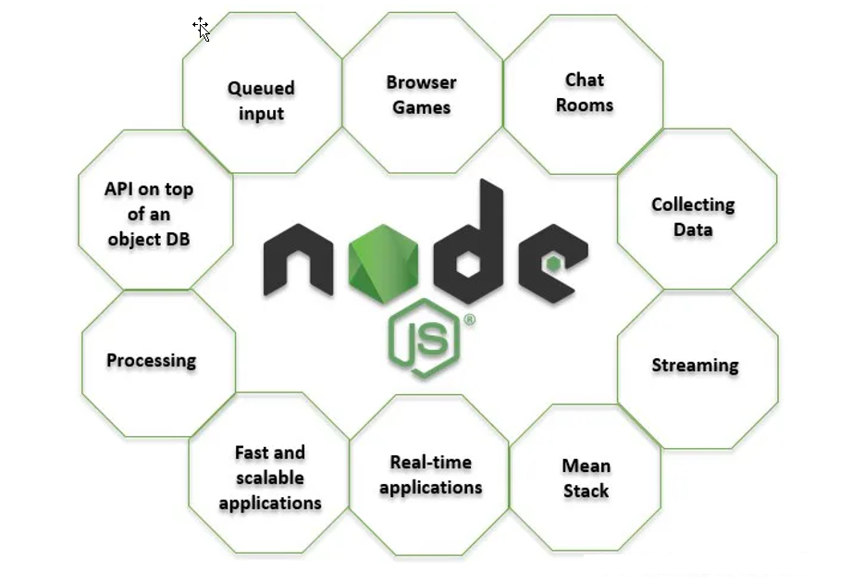
Uses of NodeJS
Build Backend Application Logic
Web Server (express)
Send Emails
DB lookup
Uses
Automation
Host a Web Server
Output to the user
Use its eco-system like PDF, EXCEL, EMAIL

Slide 10
Client Server Architecture
Request – Header + Body (option)
Client
Browser
Server
JS Code
Node JS
Response– Header + Body (Content)
GET – Read data
POST – Insert Data
PUT - Change Data
DELETE - Delete
Form Submit
HTTP Request
Ajax Call
ABAP
Java
.NET
Java Script

Slide 11
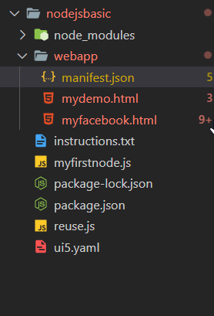
Exercise
Exercise 1: Code link for API call
Myfirstnodejs.js
Exercise 2: Code link for view page source on local
Myfirstnodejs.js
myfacebook.html
mydemo.html
manifest.json
Instructions.txt

Slide 12

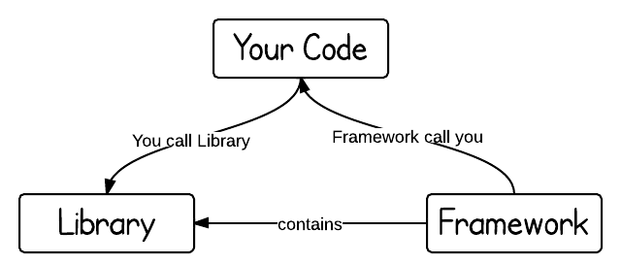
Introduction to UI5
SAPUI5 (SAP user interface for HTML5) or Open UI5 is a collection of libraries that you can use to build desktop and mobile applications that run in a browser. With the SAPUI5 JavaScript toolkit, you can create web applications using HTML5 web development standards.
SAP UI5 is a framework which is used to develop Responsive web applications to run on any platform, any browser and any OS.
Framework: - A framework, or software framework, is a platform for developing software applications. It provides a foundation on which software developers can build programs for a specific platform.
A framework may include predefined classes and functions that can be used to process input, manage hardware devices, and interact with system software.
Library: - A collection of Classes.
Classes: - Collection of methods, Attributes, Events.

Slide 13

Responsive Web Design
Responsive web design (RWD) is a web development approach that creates dynamic changes to the appearance of a web application, depending on the screen size and orientation of the device being used to view it.
Responsive Web Design is about using HTML and CSS to automatically resize, hide, shrink, or enlarge, a website, to make it look good on all devices (desktops, tablets, and phones).
Now a days, all the frameworks are designed to adept the UI according to the screen size of the device.

Slide 14
Structure of UI5 Framework
The UI5 framework is built on top of open standards like HTML5, CSS, JS, and jQuery. We use MVC architecture to create applications using SAPUI5.
BAS or
VSCode
App
SAP UI5 Design Time Component
SAPUI5 Runtime Component
HTML+CSS+JS
sap.m
sap.ui.comp
sap.ui.table
sap.ui.layout
Renderer
sap.ui.core
sap.ui.unified
sap.ui.core.mvc
HTML5
CSS
JS
jQuery

Slide 15
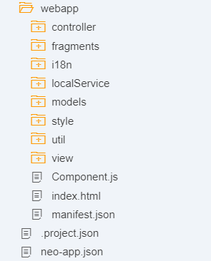
Project Structure of UI5 Project
When you create a new SAPUI5 application, you will be able to see a folder structure created in your project explorer like below.
In a SAP project there are a number of folders and files that you will not recognize if you are not familiar with MVC. Let's have a quick overview.
Within a given project, you have three core folders.
Model
View
Controller

Slide 16
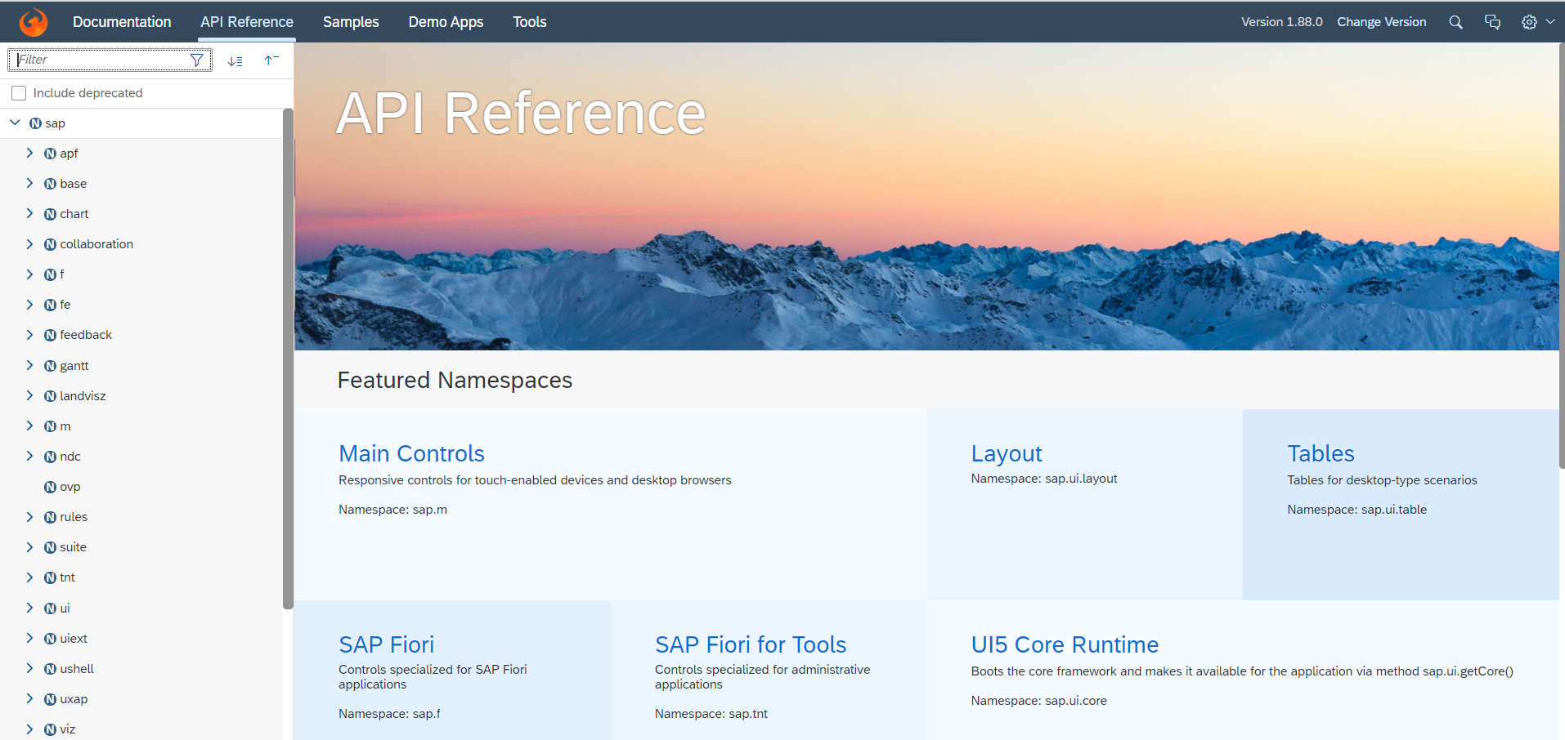
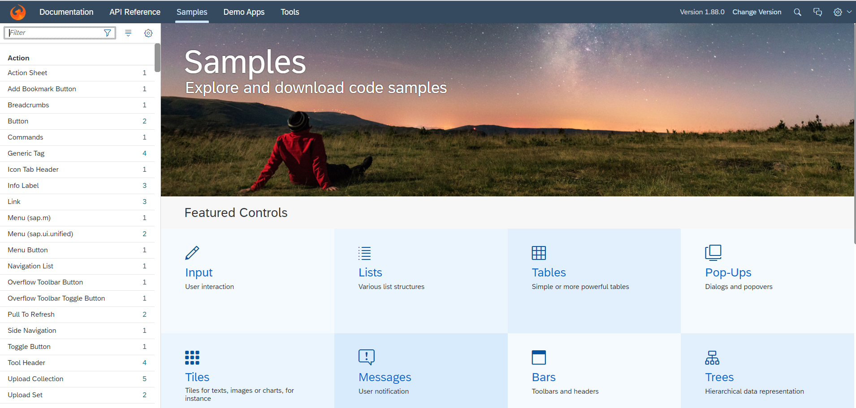
Introduction to UI5 SDK
Documentation of SAP UI5 is available at the SAPUI5 Software Development Kit.
We can access the SAP UI5 API’s at the Documentation page of SAP UI5 or you can use the link to go to sap’s API screen - https://sapui5.hana.ondemand.com/#/api
We can directly search the required api’s on the SDK.
SDK contains the sample of all the controls which we can use in UI5
SAP UI5 API reference screen
SAP UI5 Sample reference screen

Slide 17
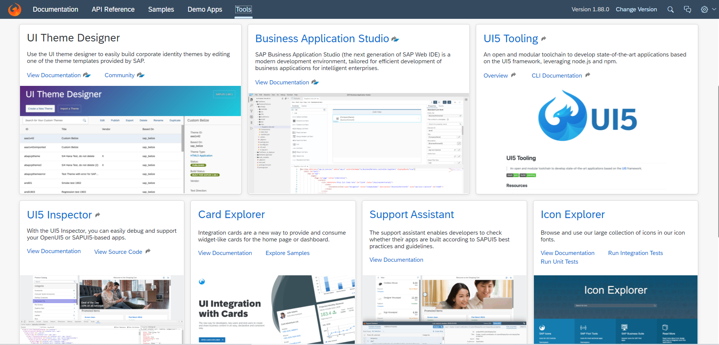
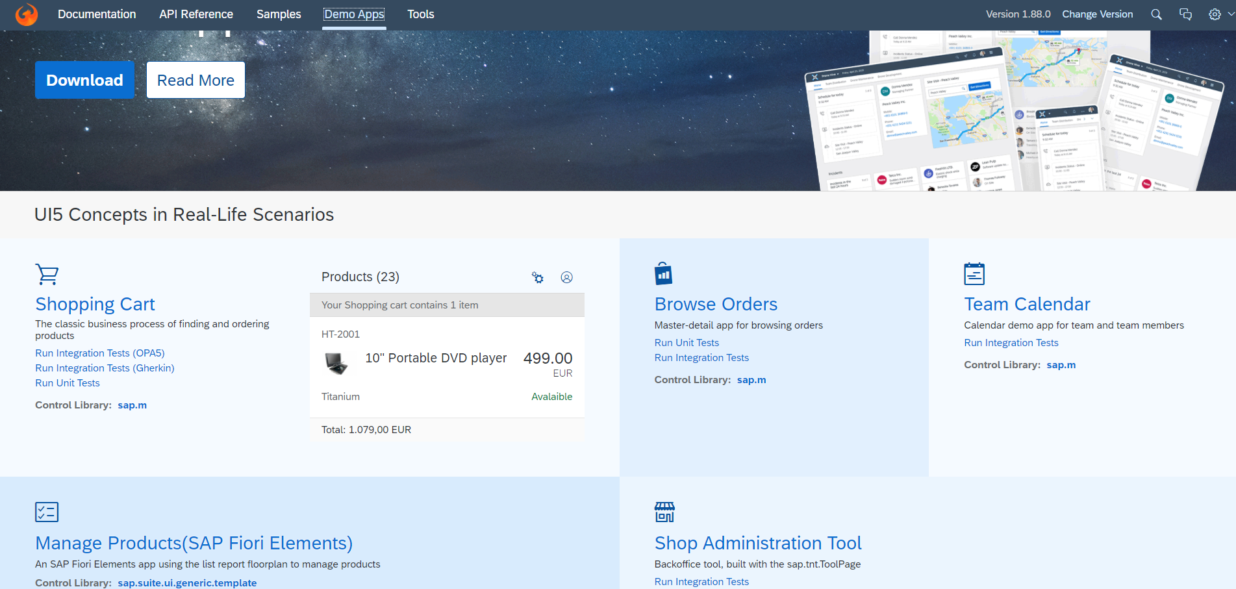
UI5 SDK continues…
UI5 SDK contains tools to make the development smooth for the developers.
It has UI5 icon packs which can be directly accessed for the UI5 SDK’s Tool Screen (Link).
SAP UI5 SDK provides us the demo application, So we can get an idea about how to create different type of applications using UI5 controls
UI5 SDK Tools Screen
UI5 SDK Demo Apps Screen

Slide 18
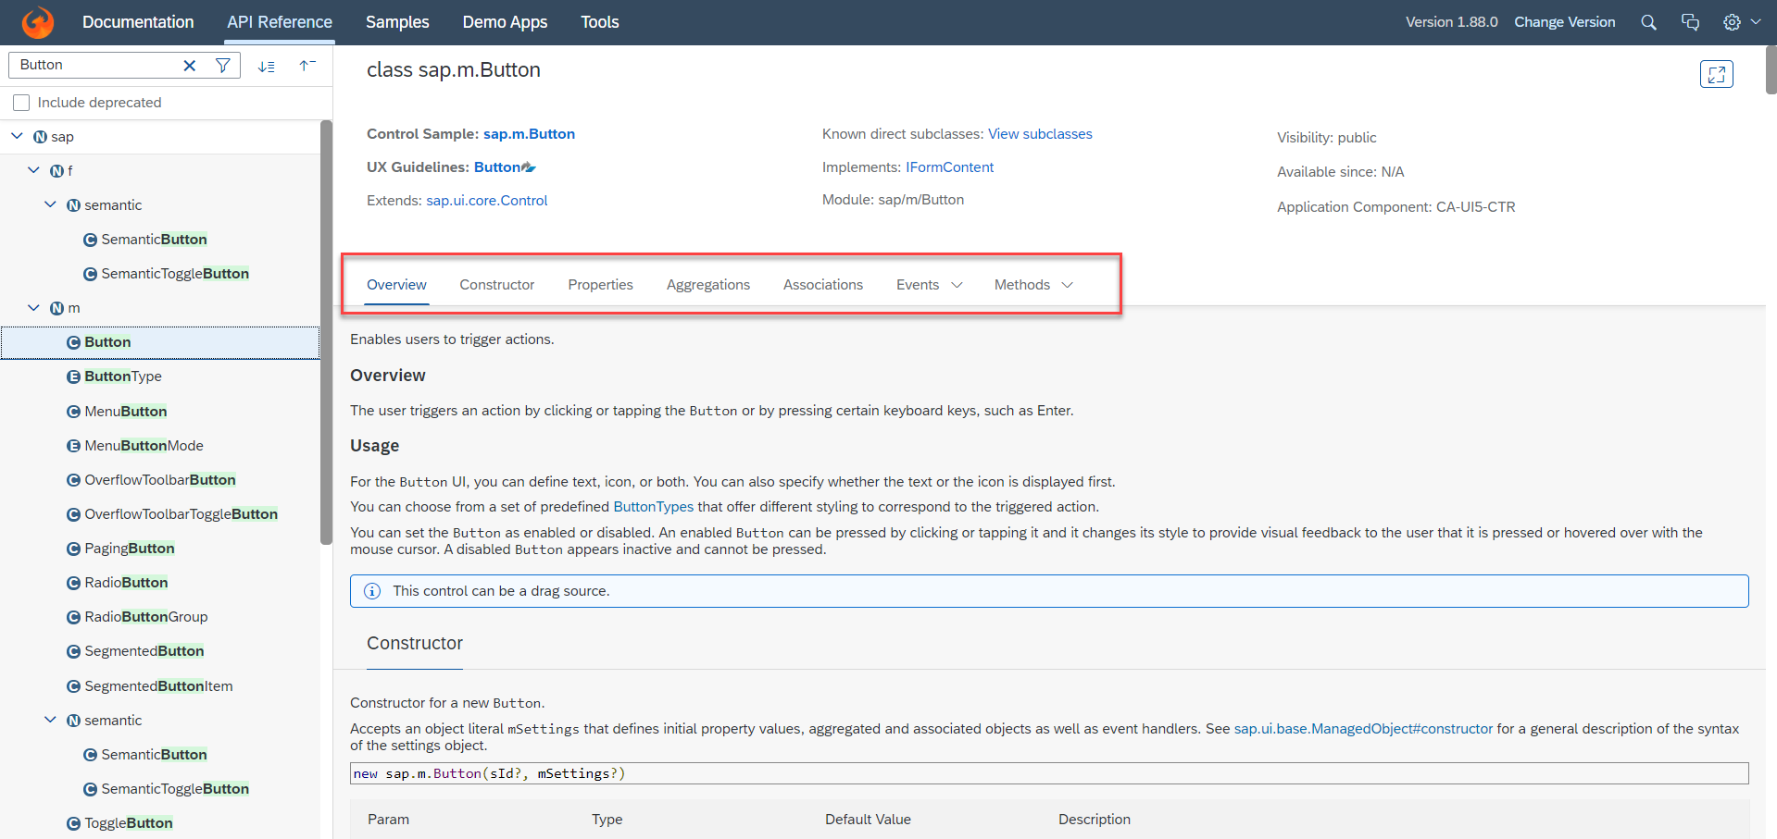
UI5 SDK continues…
When we search and open any API we see a screen similar to one which is shown below.
Every API contains different kind of:
Properties,
Aggregations,
Associations,
Events,
Methods

Slide 19

End of Day 5

Slide 20

Any Questions ?

Slide 21

Anubhav Oberoy

Slide 22
Title
Content

Slide 23
Title
Content

